Slide 1


Slide 2
Financial System

Slide 3
Agenda
This course covers broad functionalities of banks. It describes how the financial system functions and the roles that banks play in it. It also explains the primary functions of banks.
Objectives:
At the end of the course we will be able understand the following:
1- Financial System
2- Bank and Banking System
3- Types of Banks
3- Retail Banking
4- PNC Financial Services
5- PNC - Retail Banking Services
6- CGI Banking Solutions to PNC

Slide 4
Table of Contents
Introduction
Financial System
Banking
Retail Banking
PNC Financial Services
PNC Financial Services
PNC Financial Services – Retail Banking
CGI Retail Banking solutions for PNC
Glossary of Terms & Phrases in Retail Banking
4

Slide 5
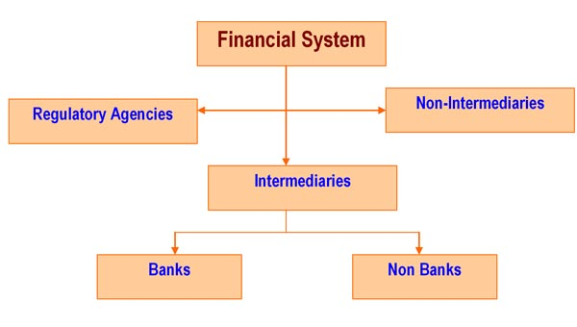
Financial System
The Financial System is a set or aggregation of institutions, instruments, markets and services which are involved in money management. Objective of financial system is to enable lenders and borrowers to exchange funds, i.e. to ensure smooth flow of money from those who have it [savers / lenders] to those who want to use it [users / borrowers], so that the latter can make an effective use of the same, in the process benefiting themselves, the savers/lenders and the economy as a whole.

Slide 6
Financial System
Financial System consists of institutions that are engaged in the business of ‘Money / Finance’. They can be classified as:
Intermediaries: Intermediaries are the financial institutions that accept deposits from the savers/ depositors and channelize the same as lending/ investment to the users / borrowers. In other words, financial intermediaries function as a bridge between the savers and the users in any economy.
Examples:
Banks
Investment Companies
Non-Banking Finance Companies [NBFCs]
Insurance companies
Mutual funds
Stock Brokerages
Credit Card Companies

Slide 7
Financial System
Non-Intermediaries: These are popularly known as Development Banks. These institutions do not accept funds / deposits from public rather they usually funded by the government or other financial institutions . Objective of these institutions is focused on developing selected areas in trade and commerce.
Examples (National & International context):
Industrial Development Bank of India (IDBI)
Industrial Investment Bank of India
Export – Import Bank of India (EXIM Bank)
Asian Development Bank
World Bank
International Monetary Fund (IMF).
State Financial Corporations(In the Indian context)
Regulatory Agencies: These are the agencies whose sole function is to monitor and regulate the functioning of the intermediaries and non-intermediaries and are referred to as ‘Regulatory Authorities’. They are like the traffic cops that lay down the “Do’s and Don’ts” for the players in the market. To make their regulations enforceable, these agencies are generally armed with punitive powers, which can be exercised in case of non-compliance by any of the players.

Slide 8
Financial System
Examples:
India
Reserve Bank of India (RBI)
Securities and Exchange Board of India (SEBI)
National Stock Exchange (NSE)
Bombay Stock Exchange ( BSE)
USA
The Federal Reserve System, Central Bank of US (The Fed)
U.S. Securities and Exchange Commission (SEC)
Financial Accounting Standard Board (FASB)
UK
FSA - Financial Services Authority - UK regulatory body

Slide 9
Financial System
Financial Services:
The term “Financial Services” is generally used to refer to the services provided by the finance industry. It is also a term used to represent organizations that deal with the management of money & provide a variety of money and investment related services. It is the largest industry in the world in terms of profits & represents over 20% of the market capitalization or the market value. The term financial services became more prevalent in the United States partly as a result of the Gramm-Leach-Bliley Act of the late 1990s, which enabled different types of companies in the US financial services industry to merge. Today almost every company which previously described itself as a bank, insurance company, or brokerage house, considers itself in some way as a financial services institution.
Important Financial Services offered include:
Banking Services
Investment Planning
Insurance Planning
Wealth Management & Estate Planning
Share Broking
Credit Cards Services

Slide 10
Financial System
Financial Instruments: Most common financial instruments are
Cheques
Demand Drafts
Shares
Trade Bills
Debentures
Bonds & Fixed Deposit Receipts
Government Securities
Treasury Bills and Commercial Papers
National Saving Certificates
Financial Markets:
The financial markets can be divided into different subtypes:
Capital markets which consist of:
o Bond markets
o Stock market
Commodity markets & Money markets
Derivatives markets & Futures markets
Foreign Exchange markets
Insurance markets

Slide 11
Quiz
Identify Regulator Agency
Industrial Investment Bank of India
World Bank
International Monetary Fund (IMF)
FSA

Slide 12
Quiz
Classify below institutions
Investment Companies
State Bank of India
Industrial Development Bank of India (IDBI)
National Stock Exchange (NSE)

Slide 13
Quiz
Q1 Answer
FSA
Q2 Answer
Investment Companies - Intermediaries
State Bank of India - Intermediaries
Industrial Development Bank of India (IDBI) – Non Intermediaries
National Stock Exchange (NSE) – Regulatory Agency

Slide 14
Bank & Banking Services

Slide 15
Bank & Banking Services
Bank:
The term bank is generally understood as an institution that holds a banking license granted by the Bank regulatory authority and is provided rights to conduct the most fundamental banking services. All Banks come under the Intermediaries categories functioning as a bridge between the savers and the users.
A Bank is a commercial institution licensed as a receiver of deposits. It is a financial institution that accepts deposits and channels the money into lending activities. It provides banking services for profit. The essential function of a bank is to provide services related to the storing of deposits and extending of credit. A bank generates profits from transaction fees on financial services and on the interest it charges for lending.
Banking Services:
Nature of services offered by a bank depends upon the type of the bank and the country, the primary services provided include
Taking deposits from the general public and issuing checking and savings accounts, keeping money safe while also allowing withdrawals when needed
Providing loans to individuals, businesses & Corporate
Enchasing cheques
Issuing credit cards, ATM, and debit cards
Storing valuables, particularly in a safe deposit box

Slide 16
Quiz
Banks are commercial institutions which can frame their own rules and can run independently – Yes / No?

Slide 17
Types of Banks

Slide 18
Types of Banks
Types of Banks
Banking activities can be characterized as retail banking and investment banking. Most banks are profit-making, private enterprises. Some are owned by government, or are non-profit making. In some jurisdictions retail and investment activities have been, separated by law.
Central Banks
Commercial Banks
Investment and Merchant Banks
Development Banks
Islamic Banks

Slide 19
Types of Banks
Central Banks:
Central Bank of each country is the apex financial institution and performs the duties of Advisory as well as Regulatory functions. They are responsible for the following broad functions:
Supervision of the banking system
Advising the government on monetary policy
Issue of bank notes and controlling currency reserves
Acting as banker to other banks
Acting as banker to government
Raising money for the government
Liaising with international financial bodies and regulators
The reserve bank of India, The US Federal Reserve, The Bank of England, The Bank of Mexico, The bank of Japan, The Bank of Canada, The Reserve Bank of Australia are few examples of Central Banks.

Slide 20
Types of Banks
Commercial / Retail Banks :
Commercial Banks are financial intermediaries whose prime function is to accept deposits from the public and provide short term loans to individuals and business. Consequently, the customer base of Commercial Banks is very large compared to other categories of the banks.
For accepting deposits, they device a number of deposit schemes (products) such as checking (current), Savings bank, Fixed Deposit and Certificates of Deposit Accounts.
Similarly for lending bank device products in the form of Business loans, Industry loans, Housing loans, Conveyance loans etc.,
Since large proportion of a Commercial bank deposits is payable on demand, bank mostly offer short-term loans. Long-term are left to Development banks and Specialized Financial Institutions (SFIs)
Banking activities are channelized through 2 broad streams:
Retail Banking caters to the needs of individuals and small business
Wholesale (Corporate) Banking targets large corporations and companies

Slide 21
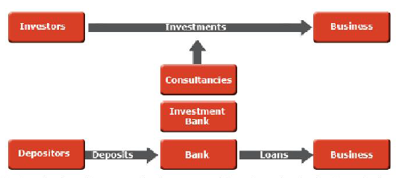
Types of Banks
Investment and Merchant Banks:
These bank are more of consultants thank banks. Generally they do not offer specific personal or business banking services to the general public. Rather, they provide strategic advisory and consultancy services for mergers, acquisitions, financial restructurings and other types of financial transactions for companies. The associated financing is raised from the Capital Markets through issue of Initial Public Offers (IPOs) and Follow-up Public Offers (FPOs).
They are intermediaries in the sense that they channelize funds directly from the investors to large borrowers, eliminating the need for the bank finance.

Slide 22
Types of Banks
Investment and Merchant Banks:
The chief distinction between an Investment Bank and a Merchant Bank is that while the latter sometimes invests its own capital in a client company, while the Investment bank only trades the securities of that company in its capital raising role. Both merchant and investment banks provide fee based corporate advisory services including Underwritings of issues.
Barclays Capital, BNP Paribas, Credit Suisse, Goldman Sachs, JPMorgan Chase and Morgan Stanly are some of the examples in these categories.
Development Banks:
These institutions are normally government sponsored and target very large developmental activities and remain focused on a particular geography or a sector.
Since their ultimate aim is overall development of that geography or a sector, they provide technical consultancies apart from finances.
These banks operate broadly at 3 levels – National, International and Regional.
Development banks at International level – World Bank (IBRD, IDA, IFC, MIGA, ICSID etc.,)
Regional level – Asia Development Bank, African Development Bank etc.,
National level – NABARD, IDBI etc.,

Slide 23
Types of Banks
Islamic Banks:
These banks undertake all the activities of commercial banking but adhere to the concepts of Islamic law.
Islamic banking revolves around well established concepts which are based on Islamic canons. Since the concept of Interest (Reba) is forbidden in Islam, all banking activities must avoid interest. Instead of interest, the Bank earns profit (mark-up) and fees on financing facilities that it extends to the customers. Its deposit makers earn a share of the Bank’s profit as opposed to a predetermined interest.
Scholars trained in Islamic law( Islamic Jurisprudence) screen the suitability of investments on an ongoing basis and provide guidance to the banks management.
Examples:
Nasir Social Bank in Egypt
Dubai Islamic Bank
Faisal Islamic Bank of Sudan
Bahrain Islamic Bank
SAMBA Bank

Slide 24
Quiz
Duties of Central Banks
Issuing of Credit Cards
Providing Personal Loans to customers
Raising money for government
Processing of cheques
Islamic banks takes Reba – Yes / No?
Investment and Merchant Banks provides services like underwriting of issues – Yes / No?

Slide 25
Quiz
Q1 Answer
Raising money for government
Q2 Answer
No
Q3 Answer
Yes

Slide 26
Banking System – India, US & UK

Slide 27
Banking System
Banking System – India
Indian Banking System is fairly complex because of the presence of a variety of banks and a phenomenal number of branches. (Possibly; in terms of sheer branch network, Indian banking system could be reckoned as the largest in the world. Incidentally, SBI is the largest bank in terms of number of branches/ personnel.
As for the structure, the Ministry of Finance is the super-regulator with RBI operating under its guidance. RBI is the regulator of the banking system in India. It is responsible for bank licensing, as well as branch licensing, issuing directives and supervising the functioning of banks.
It is empowered with punitive powers that can be exercised against errant banks. Besides the RBI, there are agencies such as the Deposit Insurance, Corporation & Guarantee Corporation of India (DICGC) and the Banking Ombudsman that have jurisdiction over banks in select matters
Categories of banks in India include: Public Sector Banks, Private Sector Banks, Foreign Banks, Cooperative Banks, Local Area Banks and Regional Rural Banks.

Slide 28
Banking System
Banking System – India
Examples of Public sector banks are SBI & its associates and nationalized banks such as Canara Bank, UCO Bank, Syndicate Bank, etc. Old generation Private sector banks include: Karur Vysya Bank, Federal Bank, Catholic Syrian Bank, etc. & those incorporated after 1992 are branded as “New Private Sector Banks. E.g.: HDFC Bank, ICICI Bank and Indusind Bank. Foreign banks are those that are incorporated outside India but carry on their operations in India under license from the RBI [E.g.: Citibank, Standard Chartered, HSBC Bank, etc.]
While the above categories of banks are treated as ‘commercial banks’, there are also other banks in India such as Cooperative Banks, Local Area Banks and Regional Rural Banks. The regulatory framework could vary in detail from one category of banks to another.
Banking System – UK
In the UK, banks that deal with the public are called ‘high Street banks. They take care of the transactional requirements of the general public. Besides, there is a unique institution by name ‘Discount House’ operating in the UK. A ‘discount house’ does not deal with the general public. Instead, it is primarily focused on dealing with banks and other financial institutions. On the regulatory front, while till eight years ago Bank of England was the regulator of the banking system, today that role is being performed by the Financial Supervision Authority [FSA].

Slide 29
Banking System
Banking System – US
The US banking system is possibly the most fragmented system one can find anywhere in the world. In the first place, there are a number of types of banks in the US: International banks, national banks, state banks and unit banks. The number of banking entities is phenomenally large in the US (around 9000). On the regulatory front, these banks/ banking entities are governed by various regulators.
Within the US itself, banking regulations differ from state to state. Till a few years back, the US banking laws were totally anti-competitive, but some of the new regulations put in place during and after 1999 has triggered consolidation of banks in the country.
Banking in United States began in 1781 with the establishment of the Bank of North America in Philadelphia. During the American Revolutionary War, the Bank was given a monopoly on currency prior to which private banks printed their own bank notes, backed by deposits of gold and/or silver.
The Bank of North America was succeeded by the First Bank of the United States, chartered in 1791which expired in 1811. Similarly, the Second Bank of the United States chartered in 1816 and shut down in 1836. The dissolution of the Second Bank of the United States in 1836 lead 18 states to establish clear rules for incorporation.

Slide 30

Banking System
Banking System – US
The first banks in the United States concentrated on providing credit to businesses, agriculture, and foreign trade operations. They did not offer services to consumers or nontraditional businesses. Even consumers did not use a bank because there was no guarantee that the money deposited into a bank would be safe.
Global Banks Predominant Business Model
Domestic Retail Banking
Retail Financial Services
International Retail Banking
Retail Banking
Advisory & Capital Markets
Corporate and Investment Banking
Asset Management and Services
Private Banking
Asset Management
Specialised Financing
Insurance
Corporate Banking
Securities Services

Slide 31

Quiz
Identify the Bank

Slide 32
Quiz
Barclays
BNP Paribas – Banque National de Paris
HSBC – Hongkong and Shanghai Banking Corporation
Deutsche Bank
ING – International Netherlands Group
CITI
RBS – Royal Bank of Scotland
Bank of America
Santander
Chase
UBS – Union Bank of Switzerland
ICBC - Industrial and Commercial Bank of China

Slide 33
Retail Banking

Slide 34
Retail Banking
Retail banking also known as Consumer Banking is the provision of services by a bank to individual consumers, rather than to companies, corporations or other banks.
Retail bank is also called as Trading bank, Savings Bank etc.,
Products offered by Retail Banks
Saving Accounts
Current Accounts
Debit Cards
Credit Cards
ATM Cards
Travelers Cheques
Mortgages
Personal Loans
Term Deposits
Services offered by Retail Banks
Savings accounts
Loans – Mortgages, Personal, Studies, Vehicles etc.,
Debit cards
Credit cards
Safe deposit vaults/lockers

Slide 35
Retail Banking
Services Provided by Retail Banks
FX transactions
Facility for bills payments
Transfer of money
Facility for issuing demand drafts
Wealth Management
Brokerage accounts
Private banking
Sub category in Retail / Consumer Banking
Private banks
Community development banks
Postal savings banks
Common terms & phrases used in Banking

Slide 36
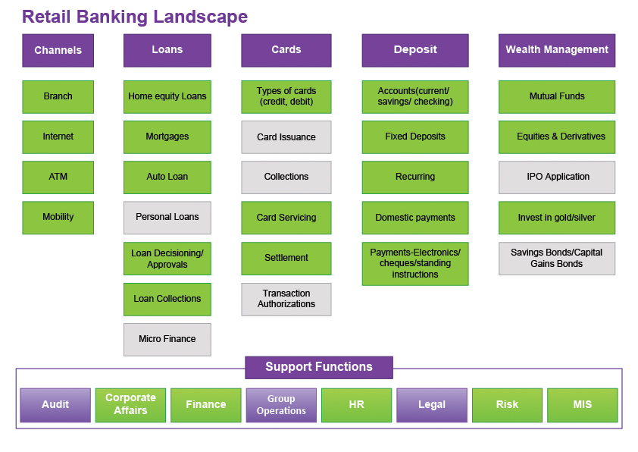
Retail Banking

Slide 37










Retail Banking
Major institutions / banks providing retail banking services
UK
HSBC Lloyds Banking Group
Royal Bank of Scotland Group Barclays
US
J.P. Morgan Chase & Co Bank of America
PNC Citigroup
India
SBI
ICICI Bank HDFC

Slide 38

PNC Financial Services

Slide 39
PNC Financial Services
PNC Financial Services Landscape
Banking
Borrowing
Investments & Retirement
Wealth Management
Checking
Mortgages
Brokerage Accounts
Asset Management
Savings
Refinancing
Managed Accounts
Asset Protection
Credit Cards
Home Loans
Education Accounts
Planning
Debit & Prepaid cards
Auto Loans
Stocks , Bonds & Funds
Personal Banking
Online & Mobile Banking
Credit Cards
Insurance
Workplace Banking
Education Lending
Retirement Accounts
Student Banking
Personal Loans
University Banking

Slide 40
PNC Financial Services
PNC Financial Services – Retail Banking Landscape
PNC Retail Banking area
Banking
Borrowing
Investments & Retirement
Wealth Management
Checking
Mortgages
Brokerage Accounts
Asset Management
Savings
Refinancing
Managed Accounts
Asset Protection
Credit Cards
Home Loans
Education Accounts
Planning
Debit & Prepaid cards
Auto Loans
Stocks , Bonds & Funds
Personal Banking
Online & Mobile Banking
Credit Cards
Insurance
Workplace Banking
Education Lending
Retirement Accounts
Student Banking
Personal Loans
University Banking

Slide 41
PNC Financial Services
CGI Retail Banking solutions to PNC
CGI Retail Banking solutions to PNC
Banking
Borrowing
Investments & Retirement
Wealth Management
Checking
Mortgages
Brokerage Accounts
Asset Management
Savings
Refinancing
Managed Accounts
Asset Protection
Credit Cards
Home Loans
Education Accounts
Planning
Debit & Prepaid cards
Auto Loans
Stocks , Bonds & Funds
Personal Banking
Online & Mobile Banking
Credit Cards
Insurance
Workplace Banking
Education Lending
Retirement Accounts
Student Banking
Personal Loans
University Banking

Slide 42
PNC Financial Services
CGI C & IB solutions to PNC
CGI Retail Banking solutions to PNC
Banking
Borrowing
Investments & Retirement
Wealth Management
Checking
Mortgages
Brokerage Accounts
Asset Management
Savings
Refinancing
Managed Accounts
Asset Protection
Credit Cards
Home Loans
Education Accounts
Planning
Debit & Prepaid cards
Auto Loans
Stocks , Bonds & Funds
Personal Banking
Online & Mobile Banking
Credit Cards
Insurance
Workplace Banking
Education Lending
Retirement Accounts
Student Banking
Personal Loans
University Banking

Slide 43
Mortgages
Mortgage Loans
A Temporary conditional pledge of property to the lender as security for performance of an obligation or repayment of a debt
It is a common debt instrument, used by individuals to purchase housing.
The borrower gives the lender a lien on the property as collateral for the loan until the mortgage is paid off in full.
If the borrower defaults on the loan, the lenders can repossess the house and sell it, to get their money back
These are Long-term loans which range from 11 to 30 years
Payment terms are primarily monthly and are typically offered through brokerage houses, agents and dealers
For the lender
o It is a Low risk –Low yield Product
o Builds Secured long term portfolio
Builds stability to Balance sheet of the Lending Institution
CGI solution to PNC in Mortgage business area

Slide 45
Corporate & Investment Bank’s Business model
CLIENT’S COVERAGE
Corporate
Institutions
Banks
Industries
Energy & Commodities
Trade Finance
Export Finance
Project Finance
Syndications
Structured Finance
Origination
Corporate Finance
Cash Management
Equity, debt, interest,
FX, Sales & Trading
CORPORATE & INVESTMENT BANKING
BOOK MANAGEMENT
Credit
Sales
Hedging

